Slide 1

Deep Learning for Time Dependent Tasks and Time Independent Tasks
Chang Xu
http://Chang-xu.github.io

Slide 2


Who am I
Joint PhD candidate, Nankai University, MSRA. Advised by Prof. Tie-Yan Liu and Prof. Gang Wang.
Research Interests: Machine Learning, Representation Learning, Reinforcement Learning
Publications
Chang Xu, Gang Wang, Xiaoguang Liu, Dongdong Guo and Tie-Yan Liu, Health Status Assessment and Failure Prediction for Hard Drives with Recurrent Neural Networks, IEEE Transactions on Computers, 2016.
Chang Xu, Yalong Bai, Jiang Bian, Bin Gao, Gang Wang, Xiaoguang Liu and Tie-Yan Liu, RC-NET: A General Approach to Incorporate Knowledge into Word Representations, CIKM, 2014.
Yuyu Zhang, Hanjun Dai, Chang Xu, Jun Feng, Taifeng Wang, Jiang Bian, Bin Wang and Tie-Yan Liu, Sequential Click Prediction for Sponsored Search with Recurrent Neural Networks, AAAI, 2014.
Yalong Bai, Kuiyuan Yang, Wei Yu, Chang Xu, Wei-Ying Ma and Tiejun Zhao, Automatic Image Dataset Construction from Click-through Logs Using Deep Neural Network, ACM MM, 2015.
Yalong Bai, Wei Yu, Tianjun Xiao, Chang Xu, Kuiyuan Yang, Wei-Ying Ma and Tiejun Zhao, Bag-of-words based deep neural network for image retrieval, ACM MM, 2014.
Fei Tian, Siyu Qiu, Chang Xu, Tie-Yan Liu, Word Embedding: Novel Representations for Natural Language in Continues Space, Journal of Data Acquisition & Processing, 2014 (In Chinese)
Selected Honors
First Place in MSR-Bing Image Retrieval Challenge at ACM Multimedia, 2014
The Google Anita Borg Memorial Scholarship: Asia Pacific, 2013

Slide 3
Content
Previous Research Projects
Knowledge powered deep learning
Incorporating Knowledge into Word Representations
Sequential deep learning
Health Status Assessment for Hard Drives
Sequential Click Prediction for Sponsored Search
On-going Project
Deep Neural Network for Posed and Spontaneous Expression Recognition
Future Project
Deep Reinforcement Learning

Slide 4
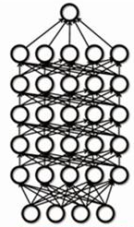
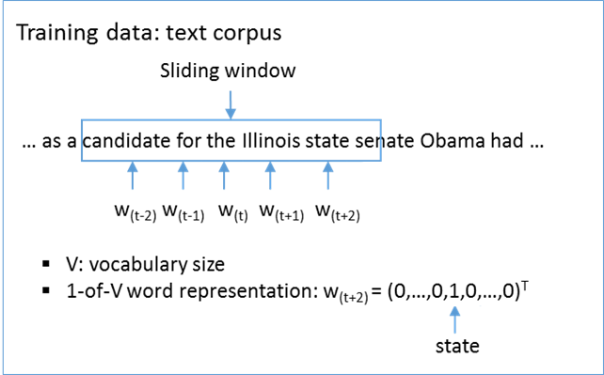
Word Embedding
Native Discrete Representation
Representations in Continuous Space
Word: 1-of-v vector
OS
$${\{w}_{1}, { w}_{2}, …, w_{i}, …, { w}_{V−1},{ w}_{V}\}$$
Deep Learning
$$\left\langle 0, 0, …, 1, …, 0, 0\right\rangle$$
Learning
Search
Mining
Retrieval
Natural Languages
State-of-the-art machine learning methods require data to be in a continuous space
Continuous representation eases text understanding, inference, and reasoning
Embedding

Slide 5
Challenges in Word Embedding
Word Representations learned from corpus
Based on the word co-occurrence information
Hard to reflect the inherent relationship between words
Noise and bias in free text
Word2Vec learns word representations from free texts in an unsupervised manner. However, free text data might be biased and noisy, thus not fully consistent with human knowledge.

Slide 6
Knowledge Graph
A kind of knowledge base
Store complex structure and unstructured knowledge.
In form of a directed or undirected graph
What can Knowledge Graph provide for learning word representation
Mapping the vertices and edges in knowledge graph space into word representations space
More powerful word representations
Knowledge Graph
United Kingdom
Alias: United Kingdom, Great Britain, UK, U.K., GB, GBR, United Kingdom of Great Britain and Ireland, Britain
King_of
Queen_of
Wife_of
George VI
Gender: Male
Child_of
Elizabeth II
Gender: Female
Prince Philip, Duke of Edinburgh
Gender: Male
Child_of
Child_of
Diana, Princess of Wales
Gender: Female
Wife_of
Charles, Prince of Wales
Gender: Male

Slide 7
Knowledge Categories in Knowledge Graph
Knowledge Graph
Relation Knowledge
Wife_of
<Elizabeth II, Prince Philip> <Diana, Charles>
King_of
<George VI, Britain>
United Kingdom
Alias: United Kingdom, Great Britain, UK, U.K., GB, GBR, United Kingdom of Great Britain and Ireland, Britain
Child_of
<Elizabeth II, George VI> <Charles, Elizabeth II> <Charles, Prince Philip>
Queen_of
<Elizabeth II, Britain>
King_of
Queen_of
Wife_of
George VI
Gender: Male
Child_of
Elizabeth II
Gender: Female
Prince Philip, Duke of Edinburgh
Gender: Male
Categorical Knowledge
Synonyms of U.K.
Britain, United Kingdom , Great Britain, UK, U.K., GB, GBR, United Kingdom of Great Britain and Ireland
Male
George VI, Prince Philip, Charles
Child_of
Child_of
Diana, Princess of Wales
Gender: Female
Wife_of
Charles, Prince of Wales
Gender: Male
Female
Elizabeth II, Diana

Slide 8
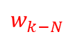
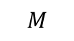
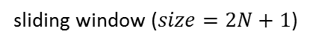
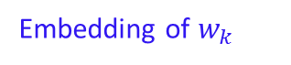

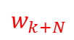
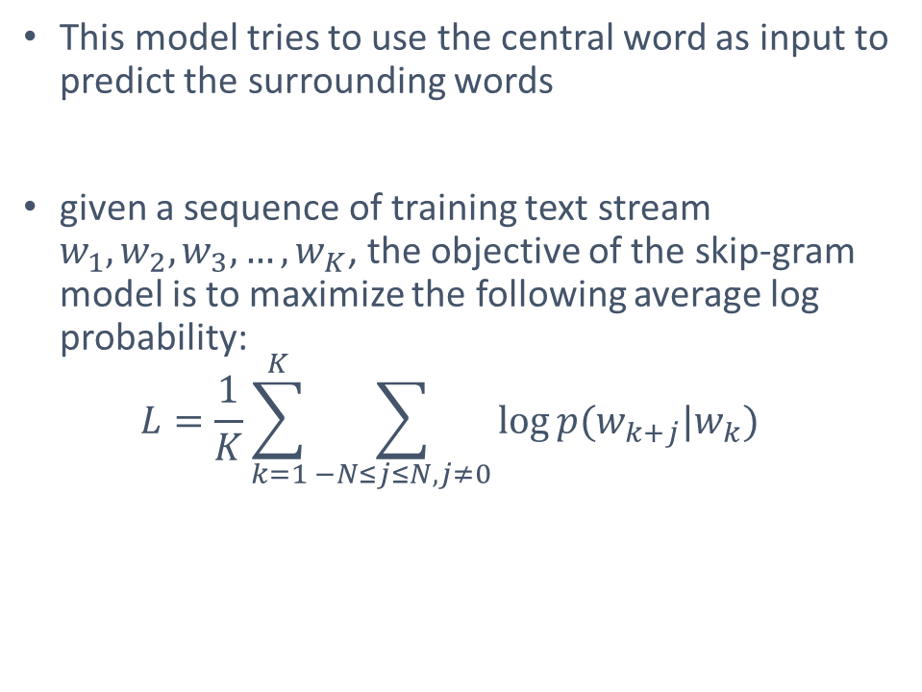
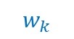
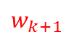

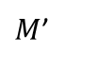
Learn from corpus: Skip-gram
This model tries to use the central word as input to predict the surrounding words
given a sequence of training text stream $w_{1},w_{2},w_{3},…, w_{K}$, the objective of the skip-gram model is to maximize the following average log probability:
$$L=\frac{1}{K}\sum_{k=1}^{K}{\sum_{−N≤j≤N, j≠0}{\log{p(w_{k+j}|w_{k})}}}$$
$$w_{k−N}$$
. . .
$$w_{k−1}$$
$$w_{k+1}$$
. . .
$$w_{k+N}$$
$$softmax$$
. . .
. . .
$M$’
Embedding of $w_{k}$
$$M$$
$$w_{k}$$
sliding window ($size=2N+1$)
$$w_{1},…,w_{k−N−1},w_{k−N},…,w_{k−1},w_{k},w_{k+1},…,w_{k+N},w_{k+N+1},…,w_{K}$$

Slide 9
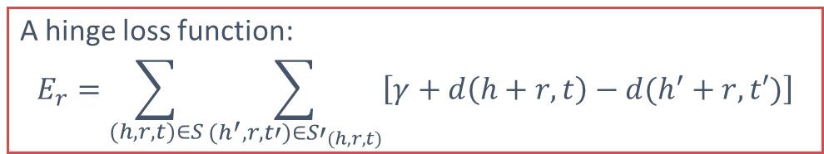
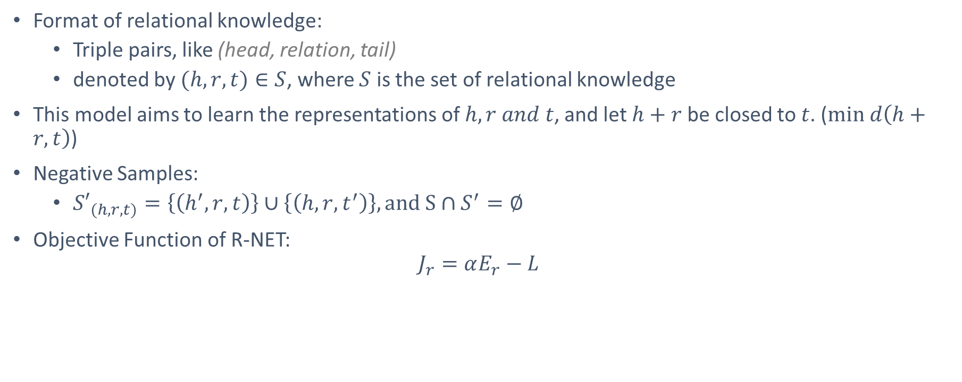
Learn from Relational knowledge: R-NET
Format of relational knowledge:
Triple pairs, like (head, relation, tail)
denoted by $(h,r,t)∈S$, where $S$ is the set of relational knowledge
This model aims to learn the representations of $h,r and t$, and let $h+r$ be closed to $t$. ($min d\left(h+r, t\right)$)
Negative Samples:
${S′}_{(h,r,t)}=\left\{\left(h^{′},r,t\right)\right\}∪\left\{\left(h,r,t^{′}\right)\right\}, and S∩S^{′}=∅$
Objective Function of R-NET:
$$J_{r}=αE_{r}−L$$
A hinge loss function:
$$E_{r}=\sum_{(h,r,t)∈S}{\sum_{(h^{′},r,t′)∈{S′}_{(h,r,t)}}{\left[γ+d\left(h+r, t\right)−d(h^{′}+r,t′)\right]}}$$
Skip-gram

Slide 10

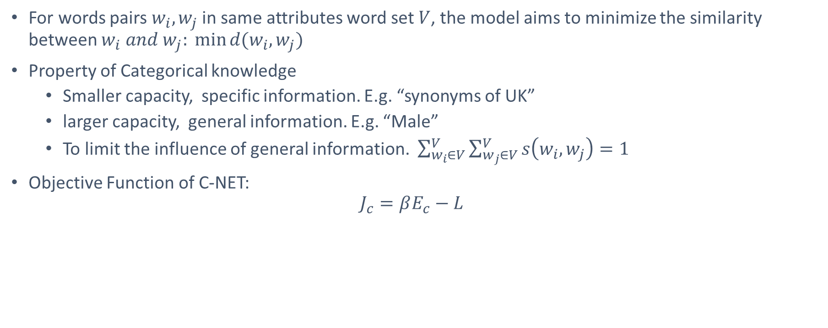
Learn from Categorical knowledge: C-NET
For words pairs $w_{i},w_{j}$ in same attributes word set $V$, the model aims to minimize the similarity between $w_{i} and w_{j}: \min{d(w_{i},w_{j})}$
Property of Categorical knowledge
Smaller capacity, specific information. E.g. “synonyms of UK”
larger capacity, general information. E.g. “Male”
To limit the influence of general information. $\sum_{w_{i}∈V}^{V}{\sum_{w_{j}∈V}^{V}{s\left(w_{i},w_{j}\right)}=1}$
Objective Function of C-NET:
$$J_{c}=βE_{c}−L$$
Skip-gram
$$E_{c}=\sum_{w_{i}∈V}^{V}{\sum_{w_{j}∈V}^{V}{s\left(w_{i},w_{j}\right)d(w_{i},w_{j})}}$$

Slide 11
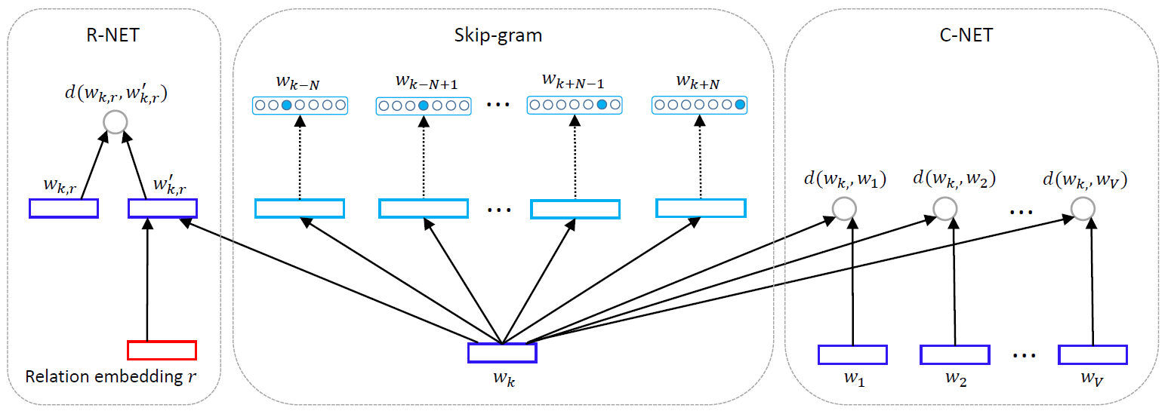
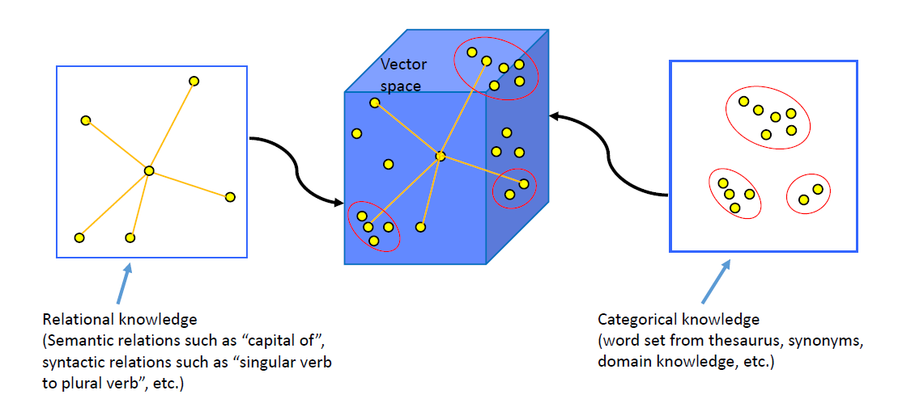
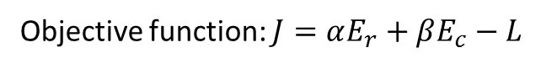
RC-NET
RC-NET
Objective function: $J=αE_{r}+βE_{c}−L$

Slide 12
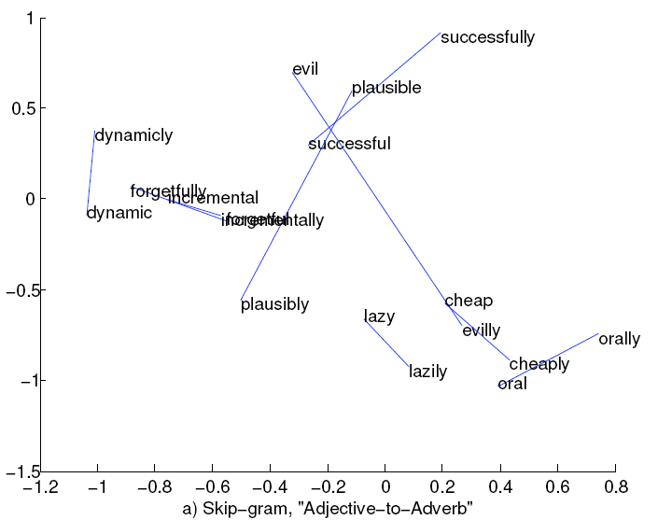
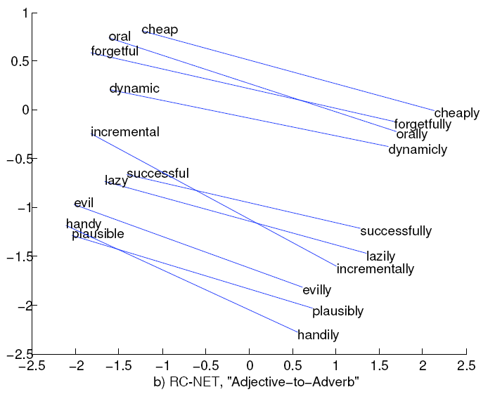
Word vector space influenced by RC-NET

Slide 13
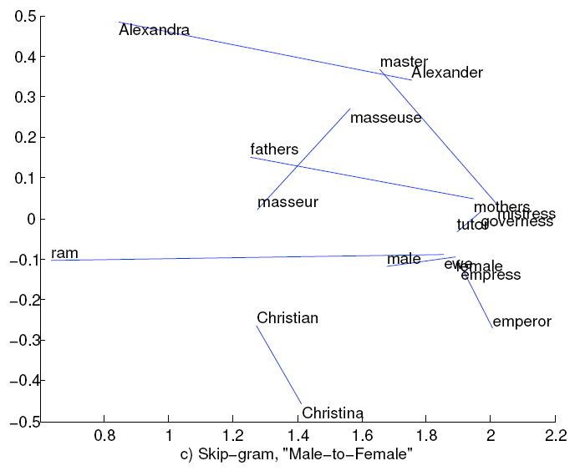
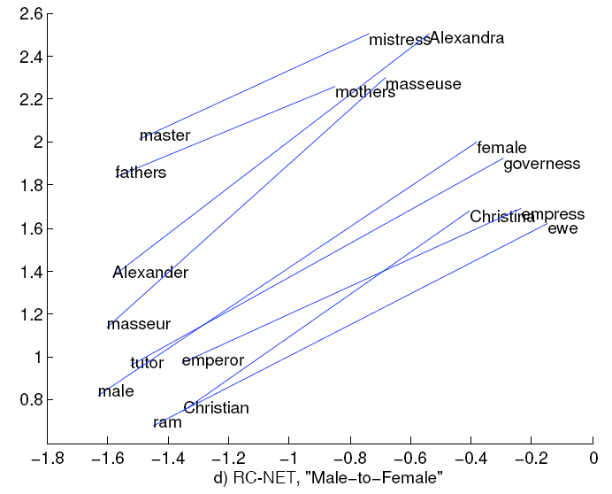
Word vector space influence by RC-NET

Slide 14
Content
Previous Research Projects
Knowledge powered deep learning
Incorporating Knowledge into Word Representations
Sequential deep learning
Health Status Assessment for Hard Drives
Sequential Click Prediction for Sponsored Search
On-going Project
Deep Neural Network for Posed and Spontaneous Expression Recognition
Future Project
Deep Reinforcement Learning

Slide 15
Sequential Click Prediction for Sponsored Search
Sponsored search has been a major business model for modern commercial Web search engines.
Click prediction is one of the fundamental problems in sponsored search.
Importance of sequential modeling in sponsored search :
Most of existing studies predict ad click independently. However, user’s behaviors highly depend on how the user previously behaved along the time.
Faceted data analysis reveals sequential dependency between user’s ad impressions.

Slide 16
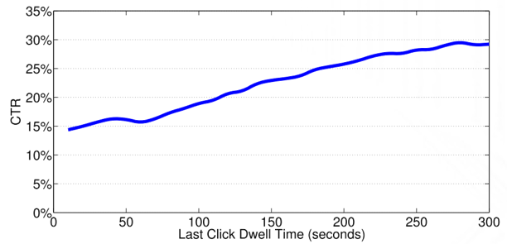
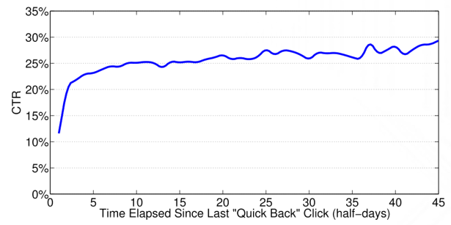
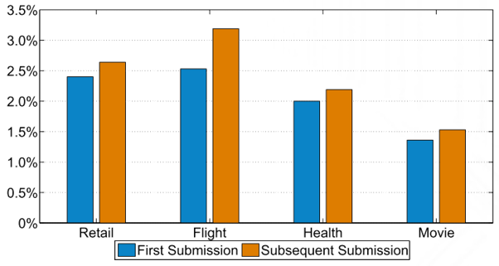
Data Analysis
User behavior is strongly and dynamically impacted by previous behavior.
There is obvious positive correlation between last click dwell time and current click-through rate.
Users tend to gradually forget the unhappy experience along with the time.
Once the user has submitted a query belonging to a certain query topic, he/she becomes more likely to click the ads under the same topic.

Slide 17
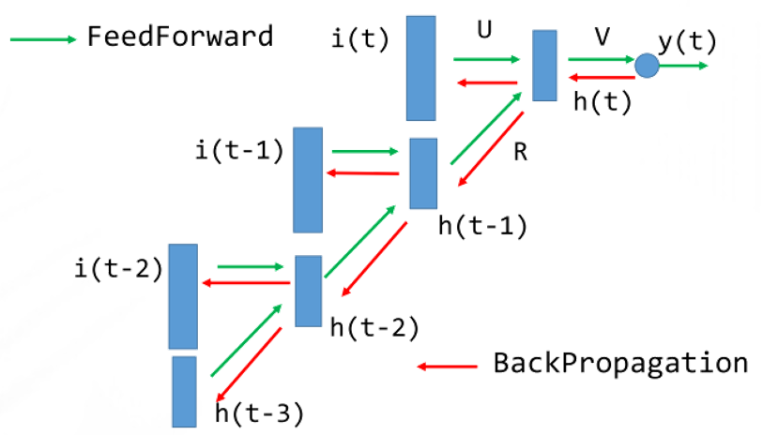
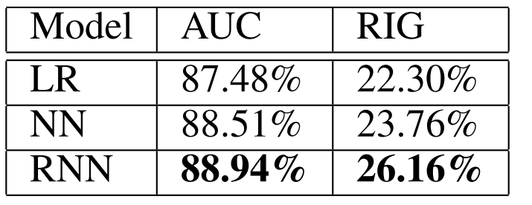
Model and Analysis
We compared Learning to Rank, Neural Network and Recurrent Neural Network for this task. RNN archived best performance.
In sponsored search, user’s behavior is affected by both the very recent events as explicit factor and the long-run history as background implicit factor.

Slide 18
Health Status Assessment for Hard Drives
Target on improving the reactive fault tolerance techniques in large scale storage systems
Log data of large scale storage systems:
SMART(Self-Monitoring, Analysis, and Reporting Technology) attributes -- logged with time stamps, in order to monitor internal attributes of individual hard drives and to raise alarms if any attribute exceeds its threshold.
Before a hard drive fails completely, there is a gradual trend towards abnormal status in SMART attributes. That is, there is a gradual process of deterioration in health status. Thus the SMART attributes can be regarded as time sequential data

Slide 19
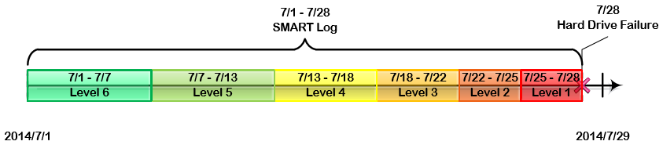
Health Degree
Most of these studies have focused on predicting failures of hard drives, i.e., labeling the status of a hard drive as “good” or not. However, in real-world storage systems, hard drives often deteriorate gradually rather than suddenly
We describe the health status of a hard drive by the length of time before it breaks down, and we deﬁne health degree by dividing the remaining time into different ranges according to the fault urgency.
Compared with the traditional binary failure prediction methods, healthy status prediction can highly improve the reliability and availability of large scale distributed storage systems.

Slide 20
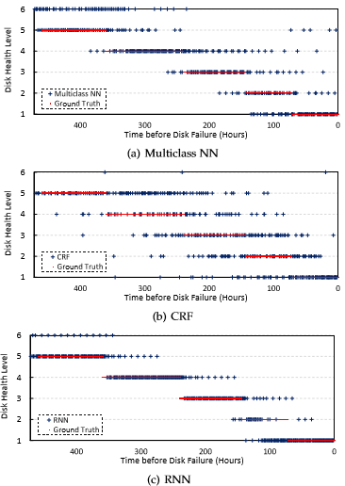
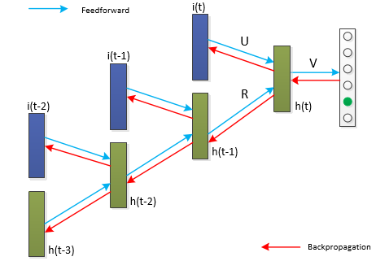
Model and Analysis

Slide 21
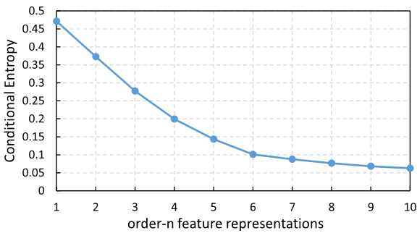
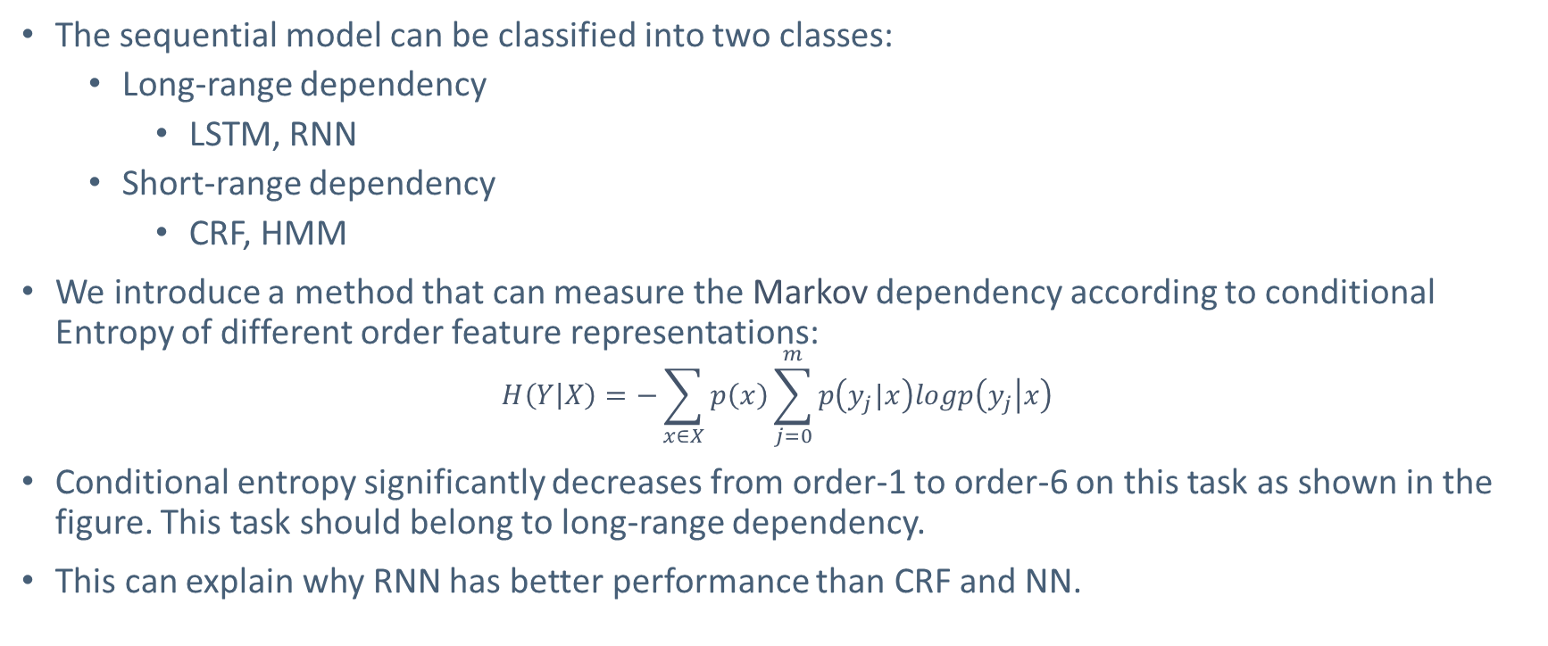
Dependency Analysis
The sequential model can be classified into two classes:
Long-range dependency
LSTM, RNN
Short-range dependency
CRF, HMM
We introduce a method that can measure the Markov dependency according to conditional Entropy of different order feature representations:
$$H\left(Y | X\right)=−\sum_{x∈X}{p\left(x\right)\sum_{j=0}^{m}{p\left(y_{j}|x\right)logp\left(y_{j} | x\right)}}$$
Conditional entropy significantly decreases from order-1 to order-6 on this task as shown in the figure. This task should belong to long-range dependency.
This can explain why RNN has better performance than CRF and NN.

Slide 22
Content
Previous Research Projects
Knowledge powered deep learning
Incorporating Knowledge into Word Representations
Sequential deep learning
Health Status Assessment for Hard Drives
Sequential Click Prediction for Sponsored Search
On-going Project
Deep Neural Network for Posed and Spontaneous Expression Recognition
Future Project
Deep Reinforcement Learning

Slide 23
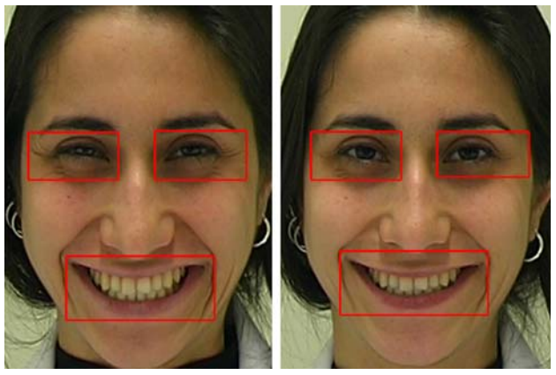
Posed and Spontaneous Expression Recognition
Posed and spontaneous expression recognition can be applied in many areas such as human-computer interaction, polygraph test, and medical diagnose
It is a more challenging task than conventional facial expression recognition.
Most of the previous works are based on Low-level features:
Tracking the dynamics of eyelid, cheek, and lip corner
movements based on landmarks.
Using discriminative completed LBP from three different
Orthogonal planes (eye, cheek and lip).
Spontaneous
Posed

Slide 24
Deep Neural Network for Posed and Spontaneous Expression Recognition
The high-level image representations usually have less noisy information
I design a new kind of layer for deep convolutional neural network to represent the difference information between the onset (the early stages of an expression) and apex (the most intense stages of an expression) facial expression in middle and high abstraction levels.
It is still hard to model the expression dynamics by only using the apex and onset expression images
I plan to design a new framework to model the appearance, shape and dynamics of facial expression by using all information of videos together.

Slide 25
Content
Previous Research Projects
Knowledge powered deep learning
Incorporating Knowledge into Word Representations
Sequential deep learning
Health Status Assessment for Hard Drives
Sequential Click Prediction for Sponsored Search
On-going Project
Deep Neural Network for Posed and Spontaneous Expression Recognition
Future Project
Deep Reinforcement Learning

Slide 26
Deep Reinforcement Learning
I plan to dive into deep reinforcement learning, a new promising area which have achieved great success recently in some AI tasks such as Atari Games and Go.
Current research topics about deep reinforcement learning include:
Addressing the exploration problem in large MDPs
Large-scale empirical evaluations
Improving existing value-function and policy search methods
Algorithms that work well with large (or continuous) action spaces
Efficient sample-based planning

Slide 27
Conclusions
Research
Knowledge powered deep learning
Sequential deep learning
Representation learning
Deep reinforcement learning
Applications
Distributed word representations
Hard disk failure/health status prediction
Click prediction for sponsored search
Posed and spontaneous expression recognition

Slide 28
Thanks!

